Slide 1
Hyperparameter optimization using Optuna

Slide 2
Hyperparameter tuning
ML algorithms have model parameters and objective functions – which are optimized during the learning process
Hyperparameter tuning is the process of intelligently searching the search space of the parameters that are specified for the learning – i.e. user input/configuration

Slide 3
Hyperparameter tuning using Optuna
ML algorithm agnostic
Study – set up range of the parameters, which sampling (optimization algorithm) algorithm to use, and whether to maximize or minimize objectives
Trial – a single run of the ML algorithm + the parameters chosen from the study configuration

Slide 4
Today’s demo
Xgboost as the ML algorithm for classification
UCI adult dataset

Slide 5
UCI adult dataset

Slide 6
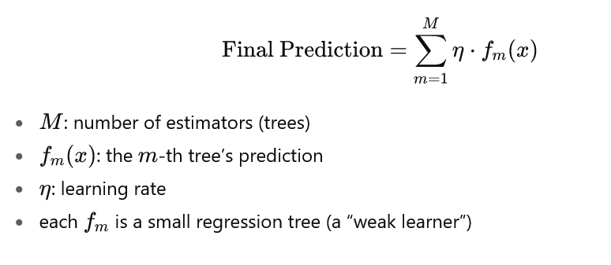
xgboost

Slide 7
xgboost
Learning rate: step size of model weight update
Number of estimators: number of trees
Max depth: depth of each tree
Guidelines
Small learning rate with larger number of estimators
Balance between stability and training speed (lower learning rate)
More depth results in potential overfitting the training data

Slide 8
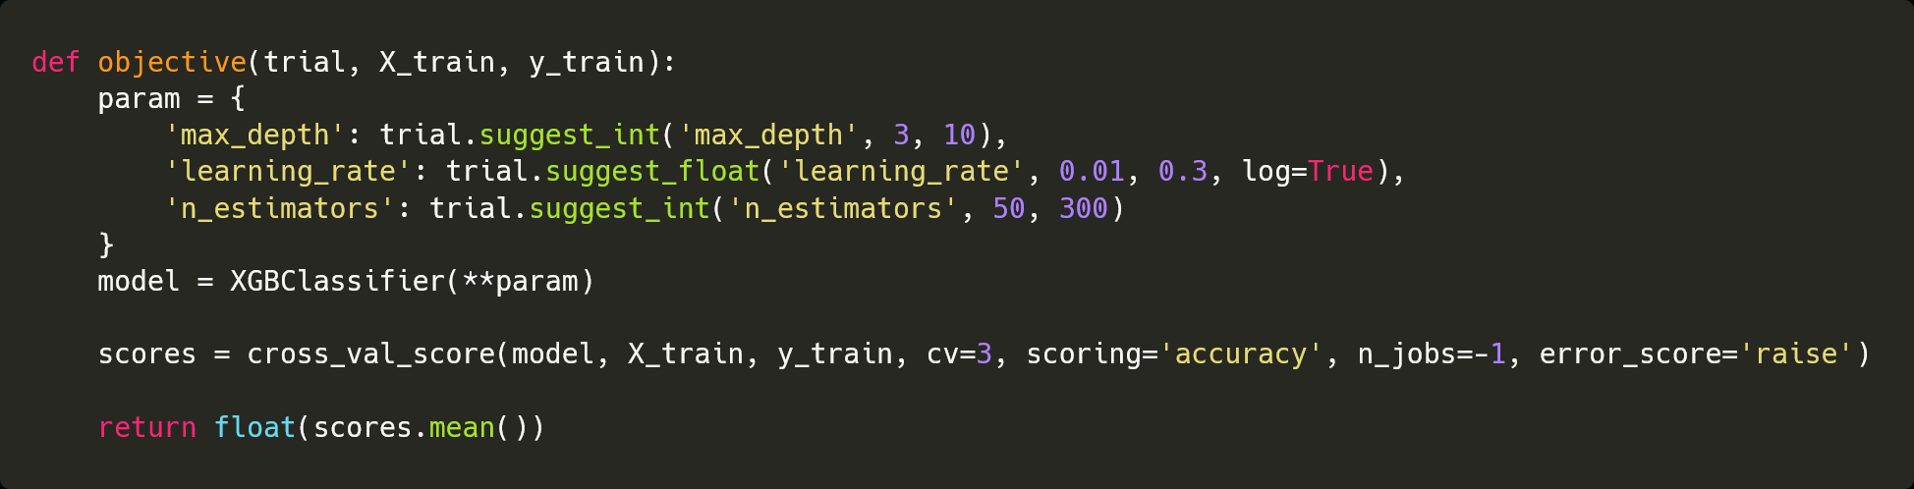
Objective function – single objective

Slide 9
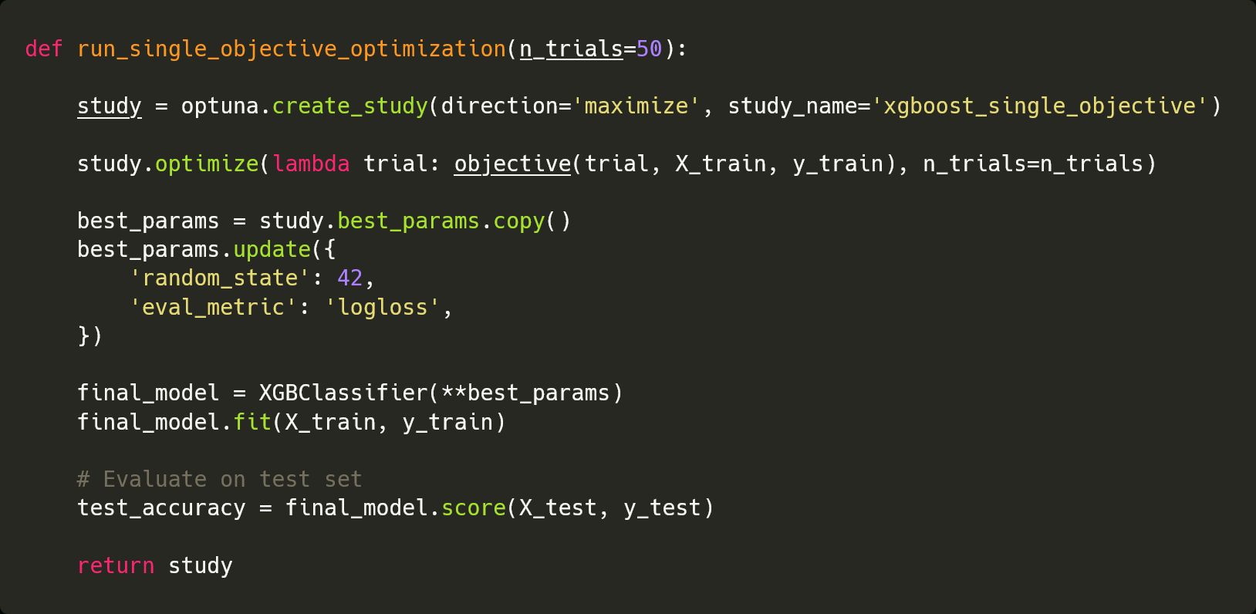
Study definition – single objective

Slide 10
DEMO

Slide 11
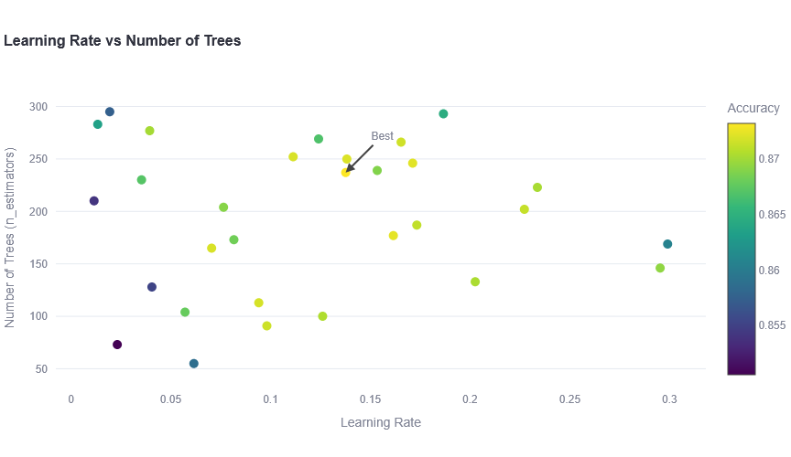
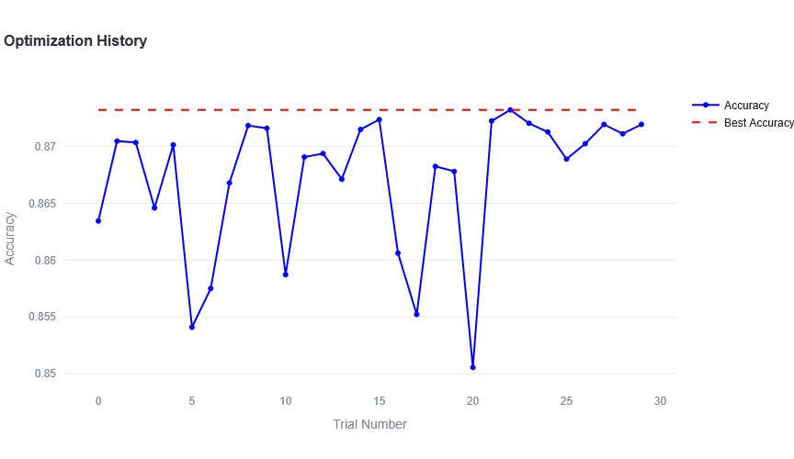

Slide 13
Objective function – multi objective

Slide 14
Study definition – multi objective

Slide 15
DEMO

